Slide 1

Today’s Agenda
10:00 AM – Introduction by Nikki Rodoni, Measure to Improve, LLC
POLL
10:20 - “The State of Recycling in California” by Teresa Bui, Special Advisor to the Director of CalRecycle
10:40 – “Recycling in Monterey County” by Tim Brownell, Director of Operations, Monterey Regional Waste Management District
11:00 – Q&A with Teresa Bui and Tim Brownell
POLL
11:25AM – Buffet Lunch Begins
11:45 – “Recycling On-Farm Plastics” by Louis Vasquez, Director of Corporate Development, Revolution Plastics
12:05 – “Innovation” by Marcy Rustad, Chief Operating Officer, Think Beyond Plastic
12:20 – Q&A with Session 2 Speakers
12:35 – “Recycling Success Stories”
POLL
Closing remarks
1:00 – Meeting Over
- Session 1 -
- Session 2 -

Slide 2
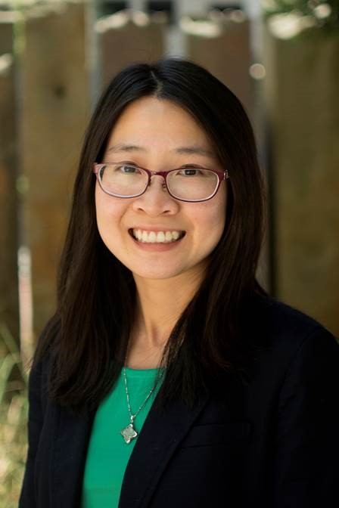
Teresa Bui
Special Advisor to the Director of CalRecycle
CalRecycle

Slide 3

State of Recycling in California
Monterey County Sustainability Working Group
– Sept 2018

Slide 4
AGENDA
CA’s Recycling Laws and Programs
Impacts of National Sword
Packaging Reform Initiative
What can you do?

Slide 5
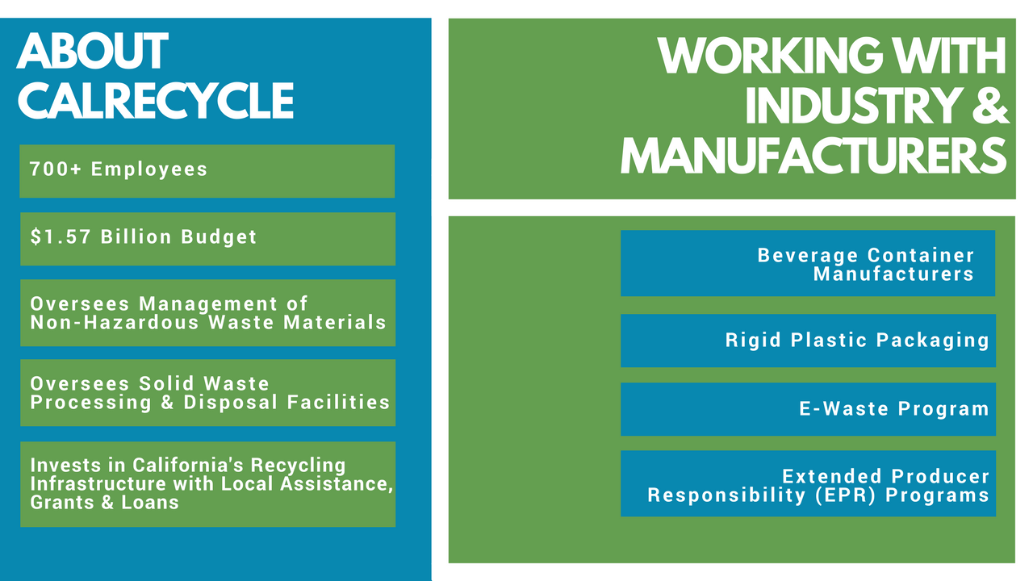

Slide 6
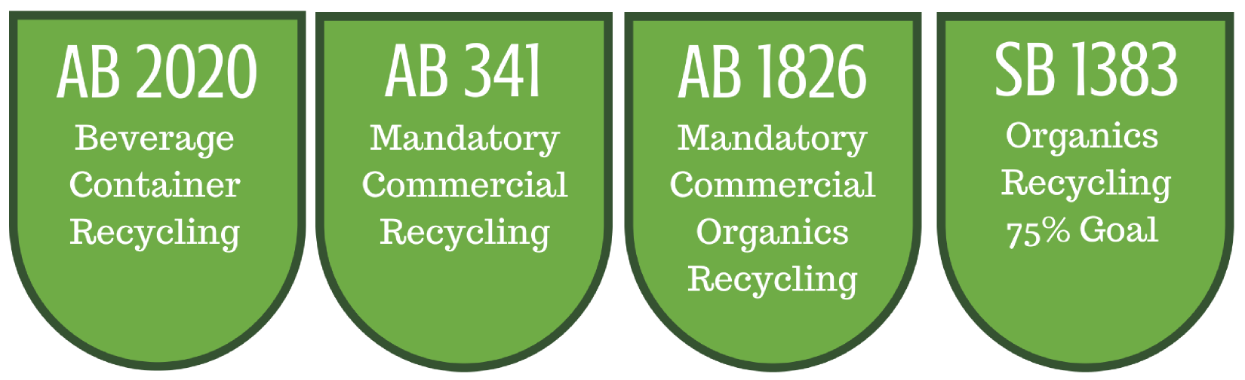
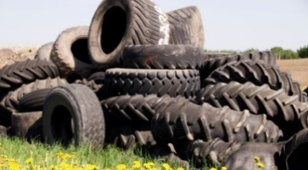
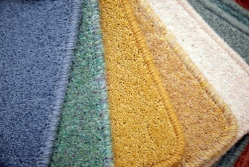
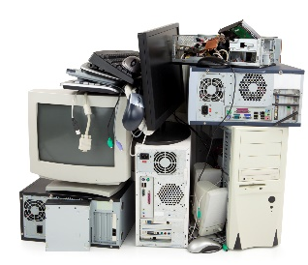
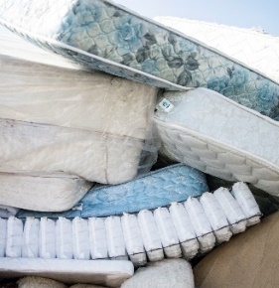


Key statutes
Producer Responsibility Programs
California Fee Programs

Slide 7
Export Market and China’s Import Ban
Roughly 1/6 of California-generated waste is exported
Export Markets Have Declined Significantly
Recent Changes to China’s Import Policies Are Impacting California Recycling
Estimated 76.5 million tons generated – AB 341

Slide 8
Exports to China – Jan 2017 vs Jan 2018

Slide 9
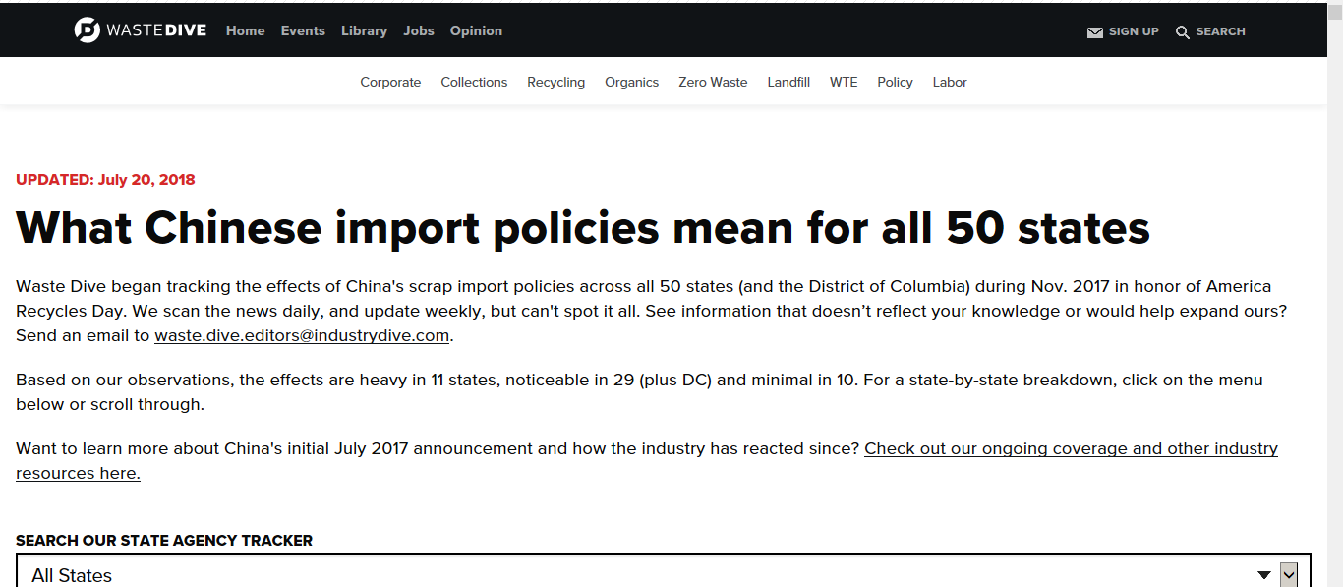
https://www.wastedive.com/news/what-chinese-import-policies-mean-for-all-50-states/510751/

Slide 10
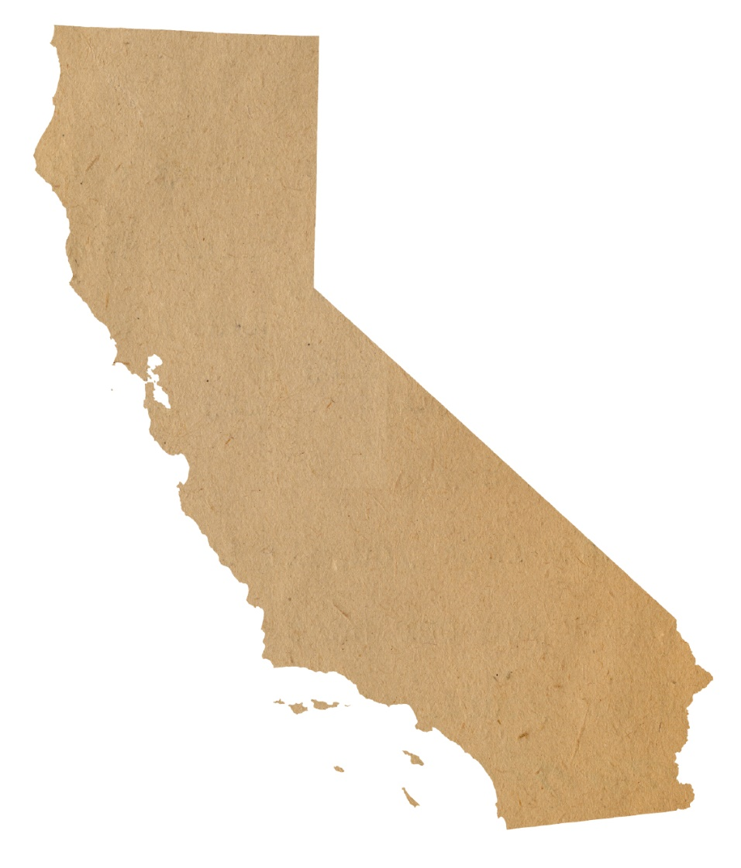
California Response
Established webpage as clearinghouse for information
Coordinating with local enforcement agencies on permit conditions for material storage
Coordinating with jurisdictions to share examples of local actions

Slide 11
SB 1383 Requirements
50 Percent Reduction in Landfilled Organic Waste
(11.5 Million Tons Allowed Organic Waste Disposal)
2020
75 Percent Reduction in Landfilled Organic Waste
(5.7 Million Tons Allowed Organic Waste Disposal)
2025
20 Percent Increase in Recovery of Currently Disposed Edible Food
2025

Slide 12
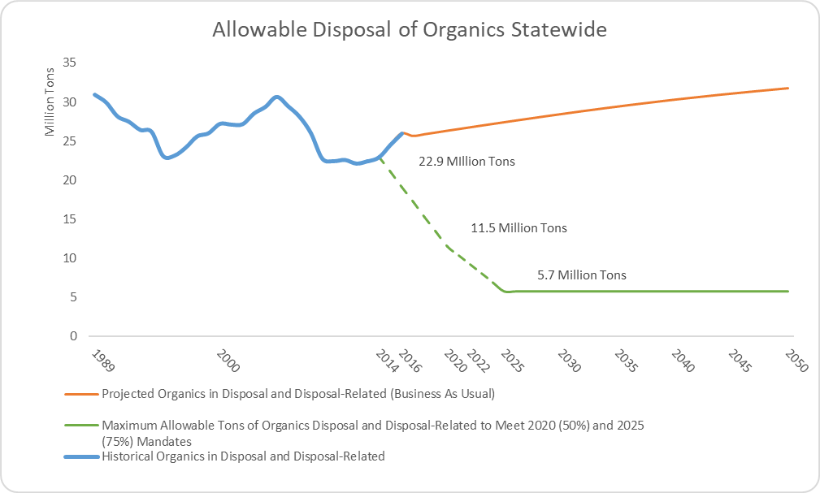
Organic Waste Reduction Targets
By 2020
10 Million TPY
2025 →
20+ Million TPY

Slide 13
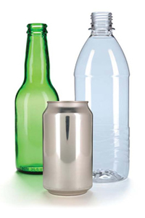

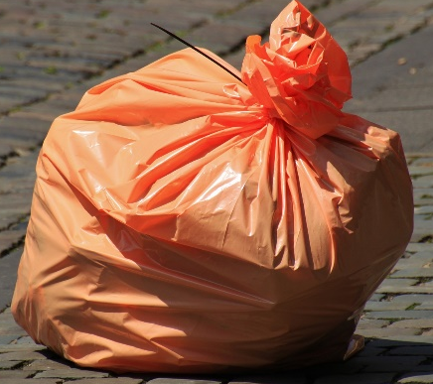
Existing State Packaging Policies
Deposit System
Bottle Bill
Minimum Recycled Content
-Rigid Plastic Packaging Containers (RPPC)
-Trash Bags
Bans
Single use Plastic Bags

Slide 14
Policy Drivers
AB 341
75% Recycling Goal
Drought
Wildfires
Climate Change
Existing Statutory & Regulatory Requirements
Marine Debris & Water Pollution

Slide 15


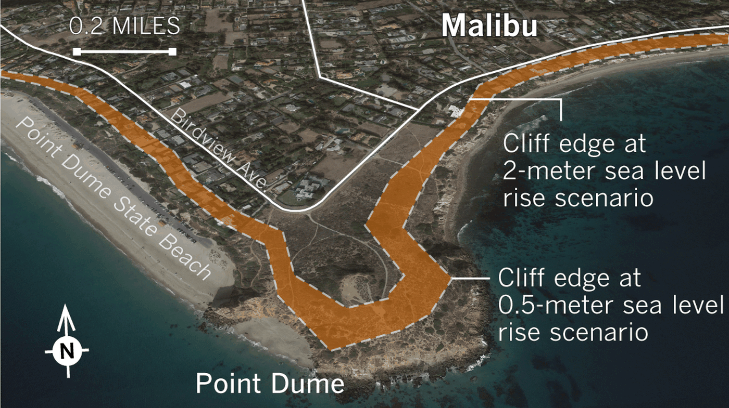
Climate Change Negatively Impacts California
Methane Gas Contributes to Climate Change in California
Increase in Many Health Risks
Increase in Wildfire and Coastal Erosion

Slide 16
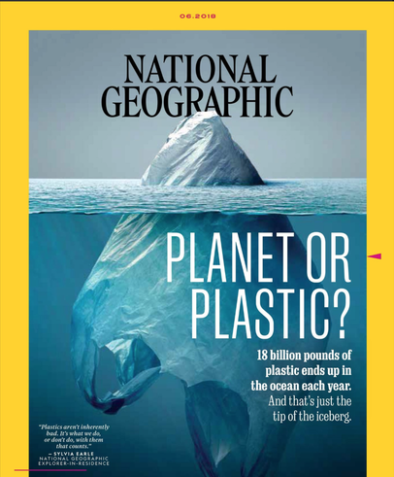
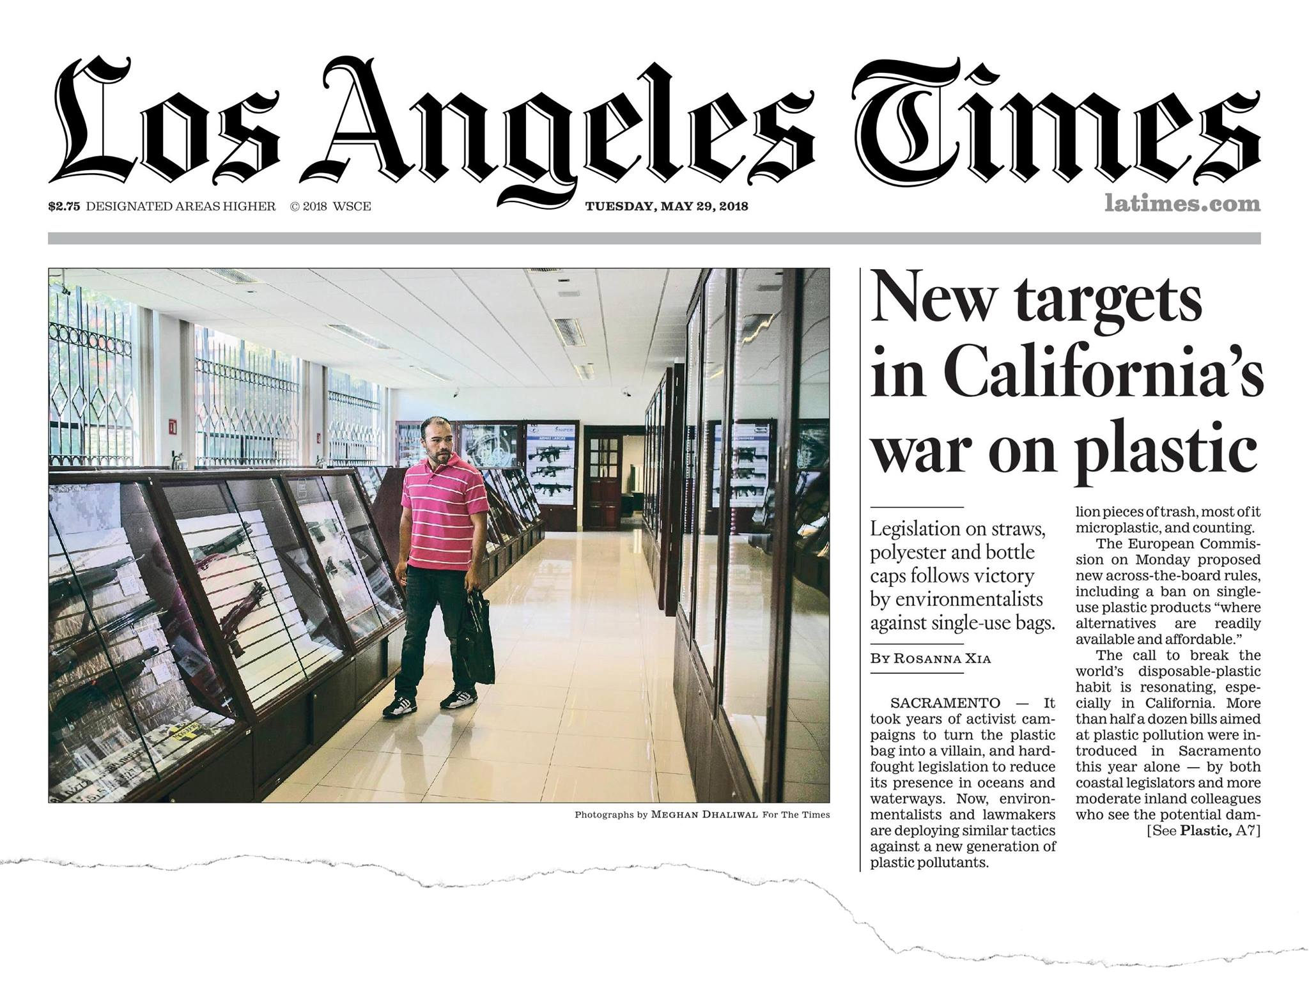


Slide 17

State of Recycling and Disposal
42.7 Million Tons Disposed
2016
44 Percent Recycling Rate
Statewide Goals
75% Recycling, Composting and Source Reduction
Greenhouse Gas Reduction

Slide 18
Statewide Projected Disposal Rate
24 million tons

Slide 19
Packaging in California’s Disposal Stream
Packaging Waste
Non-Packaging Waste
Based on data from CalRecycle 2014 waste characterization studies

Slide 20
Packaging Material Types Disposed
Most Prominent Packaging Material Types
Plastic – 2.3 Million Tons
Fiber (Paper) – 5.1 Million Tons
Based on Data from CalRecycle 2014 Waste Characterization Studies

Slide 21
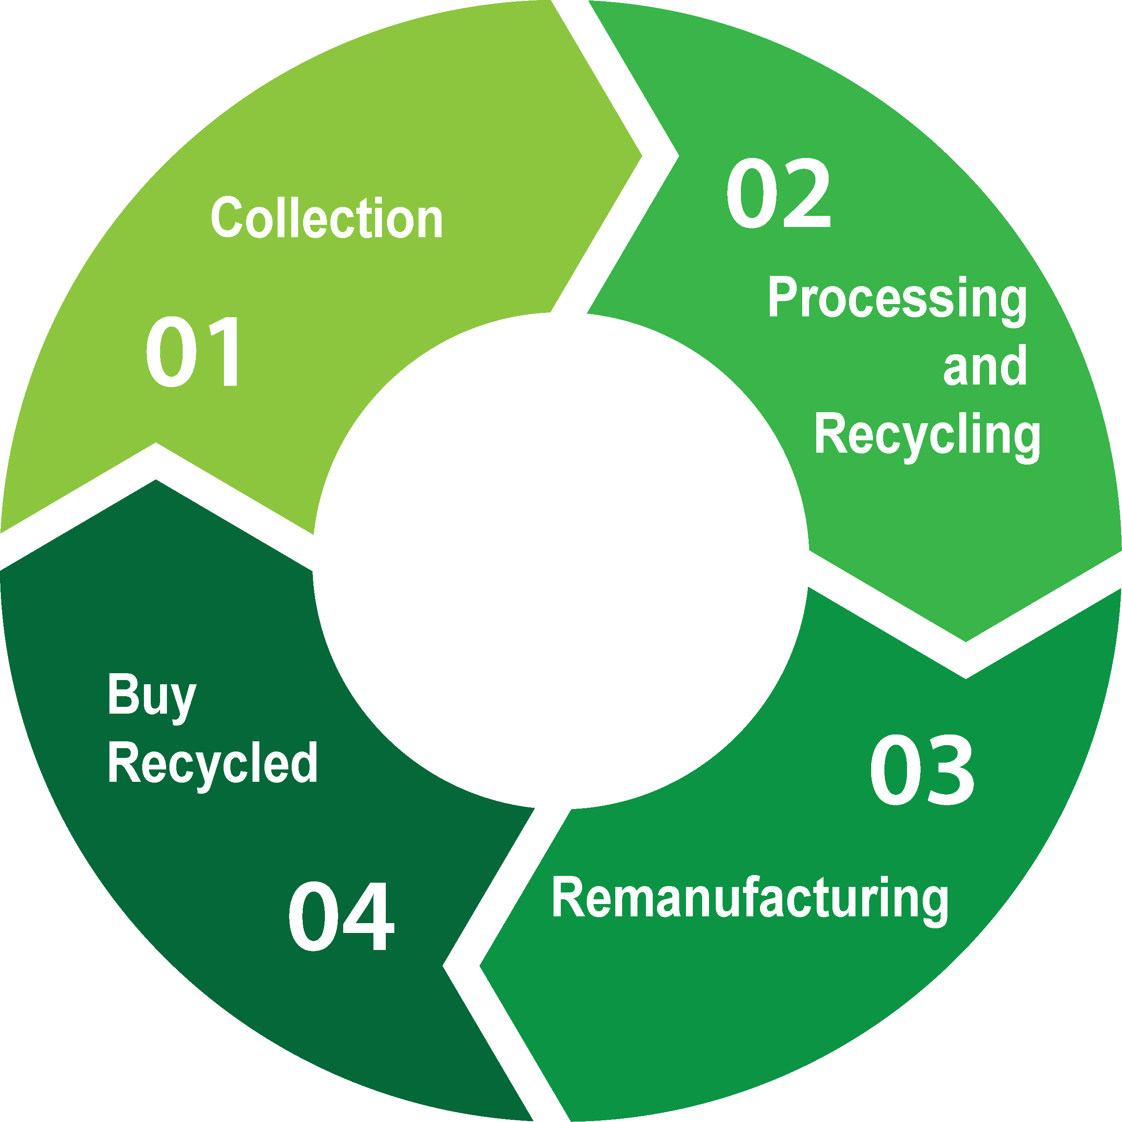
A Robust Closed-Loop Recycling Infrastructure

Slide 22
CalRecycle’s Packaging Activities
July 2017
Draft Screening Criteria Released
Nov. 2014
Packaging Policy Workshop
Oct. 2011
75% Recycling Goal Established
AB 341
March 2017
Packaging Reform Workshop
Nov. 2015
2014 Waste Characterization Study Released
Oct. 2017
Packaging Reform Workshop
Dec. 2013
Bioplastics Workshop
Dec. 2012 & July 2013
Meetings with Companies
Dec. 2016
Public Meeting
Dec. 2013
Packaging Workshop: Opportunities and Challenges
2018
CalRecycle Finalizes Packaging Policy Model
Jan. 2016
Manufacturer’s Challenge Workshop

Slide 23
Divert a significant amount of packaging from landfill
Promote source reduction, recycling, and higher uses of packaging
Address other environmental impacts of discarded packaging (GHG, marine debris, etc.)
Develop in-state and domestic infrastructure to manage post-consumer packaging
CalRecycle’s Goals for Packaging Reform

Slide 24
Strategy to manage all packaging in California
Includes enforceable metrics and goals
Manage significant amounts of packaging currently going into landfills
Authority to identify priority packaging products and implement appropriate tools
What Does a Comprehensive Packaging Policy Mean?

Slide 25
What Is Included in Packaging?
All Packaging Material Types in California Market
Primary, Secondary,
and Tertiary
Packaging

Slide 26
Essential Components for a Statewide Policy for Packaging
Comprehensive and Flexible
Consistent Process
Recognizes Prior Innovations
Transparent Process with Robust Public Participation
Specific and Enforceable Goals and Metrics
Addresses Pre- and Post-Consumer Life of Packaging

Slide 27
What can you do ?
Use reusable containers and systems
Expect more from your vendors
Apply Compost

Slide 28
reusable
Benefit of Reusables
Transport packaging is used to ship ingredients, parts and products within a facility or between producers, manufacturers, wholesalers and retailers. Common examples include pallets, cardboard boxes, and plastic stretch film.
Most transport packaging has a short life span. Stretch film and cardboard containers typically are used just once, while most pallets are used around 5 times.
Reusable transport packaging replaces limited-use transport packaging with durable alternatives, designed for many years of use
Resource: http://www.usereusables.org Cost Calculator

Slide 29

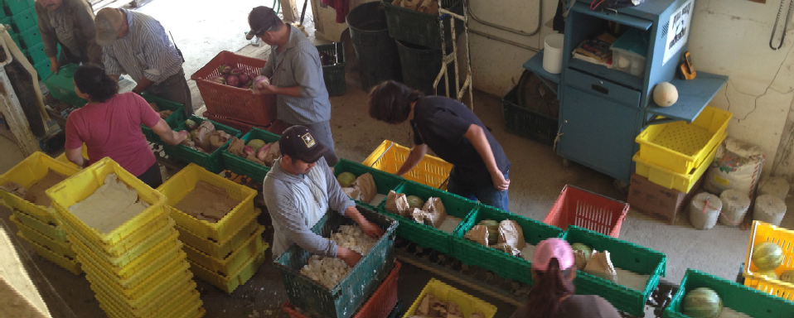
Case Study – Full Belly Farm
Annual cost savings of $14,161 in avoided waxed cardboard
box purchases.
Avoided 6.54 tons of cardboard waste annually.
Eliminated 34.1 tons of greenhouse gas emission annually.

Slide 30
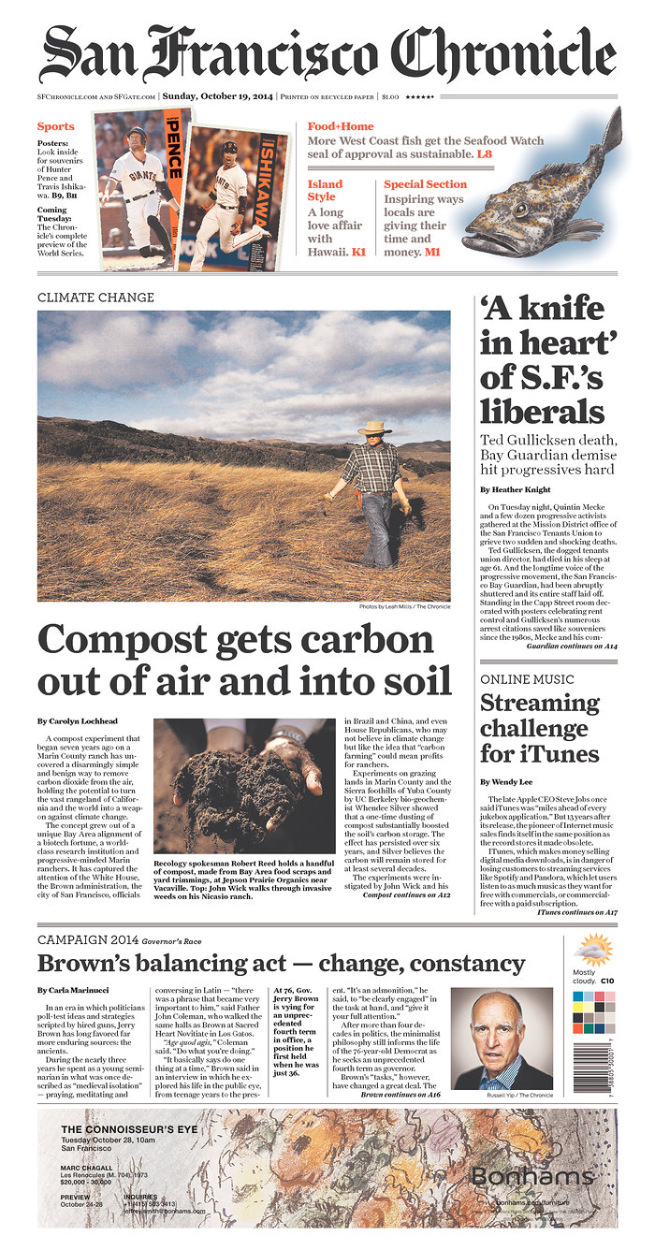
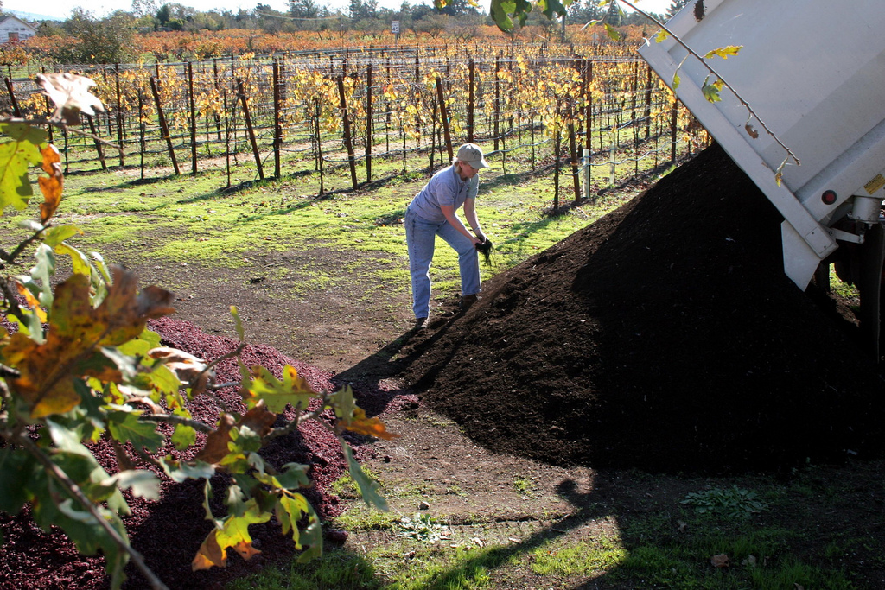
Organics

Slide 31





Stay
Engaged
Subscribe to the Packaging Listerv:
http://www.calrecycle.ca.gov/Listservs/Subscribe.aspx?ListID=153
Packaging Webpage
http://www.calrecycle.ca.gov/reducewaste/Packaging/Events/default.htm
Teresa Bui
(916) 341-6125
teresa.bui@
calrecycle.ca.gov

Slide 32








THANK YOU TO OUR EVENT SPONSORS
THANK YOU TO OUR LUNCH SPONSORS
THANK YOU TO CSUMB @ SALINAS CITY CENTER

Slide 33
THANK YOU
FOR PARTICIPATING IN TODAY’S MEETING www.mcswg.org
Contact:
Nikki Rodoni nikki@measuretoimprovellc.com
831.594.7972

