Slide 1
Today’s Agenda 10:00 AM – Introduction by Nikki Rodoni, Measure to Improve, LLC POLL 10:20 - “The State of Recycling in California” by Teresa Bui, Special Advisor to the Director of CalRecycle 10:40 – “Recycling in Monterey County” by Tim Brownell, Director of Operations, Monterey Regional Waste Management District 11:00 – Q&A with Teresa Bui and Tim Brownell POLL 11:25AM – Buffet Lunch Begins 11:45 – “Recycling On-Farm Plastics” by Louis Vasquez, Director of Corporate Development, Revolution Plastics 12:05 – “Innovation” by Marcy Rustad, Chief Operating Officer, Think Beyond Plastic 12:20 – Q&A with Session 2 Speakers 12:35 – “Recycling Success Stories” POLL Closing remarks 1:00 – Meeting Over
- Session 1 -
- Session 2 -

Slide 2
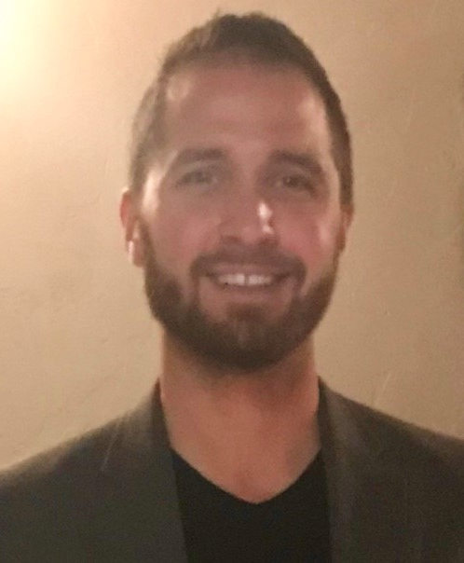
Louis Vasquez
Director of Corporate Development
Revolution Plastics

Slide 3
Extended Producer Responsibility in the Agricultural Film Market
Louis Vasquez, Director of Corporate Development
The Future of Recycling: Monterey County Produce Industry
September 2018

Slide 4
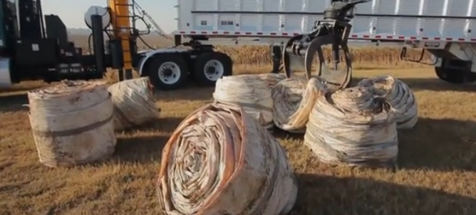
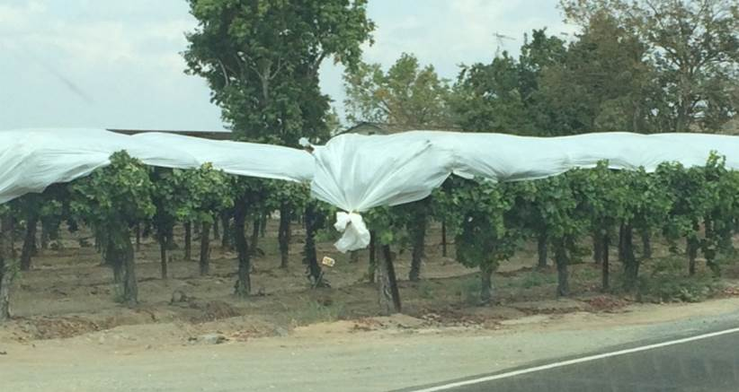
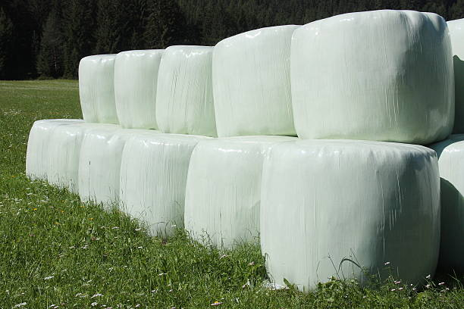
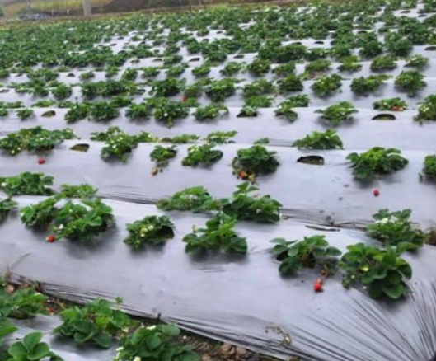
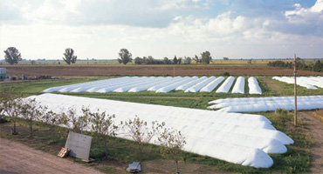
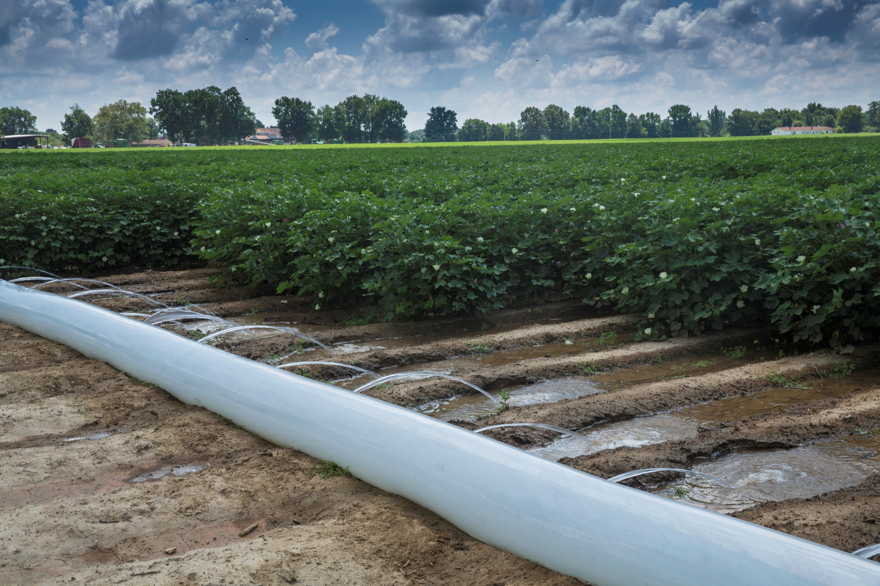
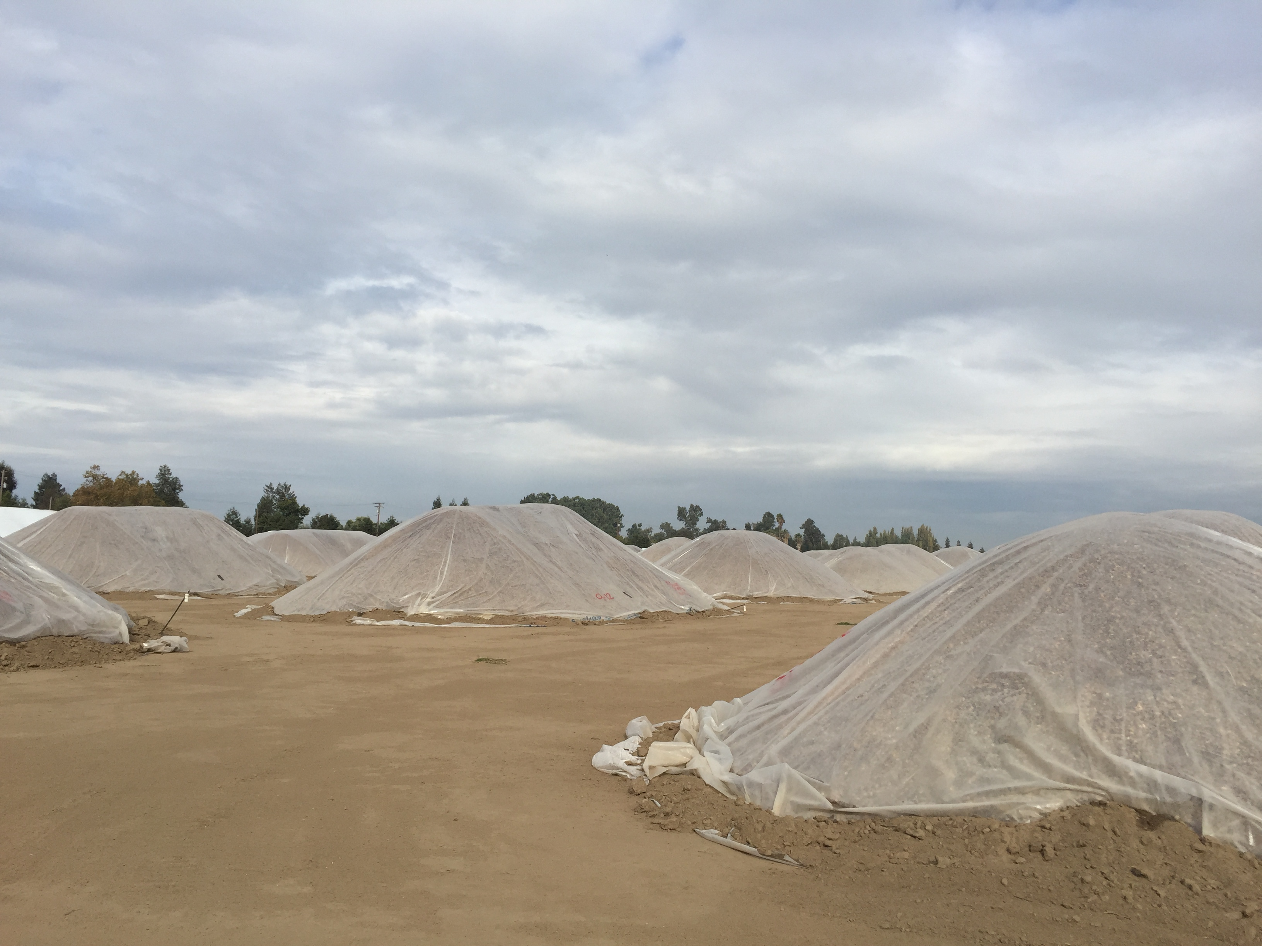
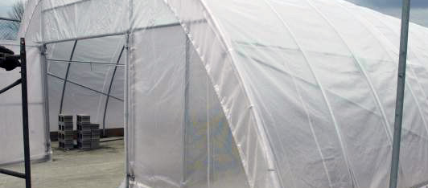
Commercial Agricultural Films
Driving Innovation in Agriculture
Improves Yield
Cost Effective
Easy to Use

Slide 5
Extended Producer Responsibility
Producer obligation to integrate all stages of a product’s lifecycle into design and distribution
Design with recycling in mind
Maintain performance standards
Ensure proper disposal

Slide 6
Conflicted State of the Film Market
Increasing Film Supply
User
Growing Eco-Demands
Improve crop yields
Minimize farm operation costs
Employ reliable products on crops
Public desire for green industries
Customers want recycled products
Growing environmental legislation
Plastic goods
Used plastic
Producer
Recycler
Postconsumer resin

Slide 7
Producer Decisions Effect Recyclers
Producer
Recycler
Cause
Effect
Design products with multiple base materials
Multi-material products cannot be recycled
Deficient product design introduces auxiliary material
Increase sortation costs and erratic recycling success

Slide 8
Finding A Successful Solution
Producers
Consumers
Recyclers
Design for Recycling
Collect Consistent Material Supply
High-Value Transactions
Strong Product Demand
Efficient Solutions
Meet Performance Specifications
Input Viable Materials
Ensure Proper Disposal
Deliver Innovative Recycling Systems

Slide 9
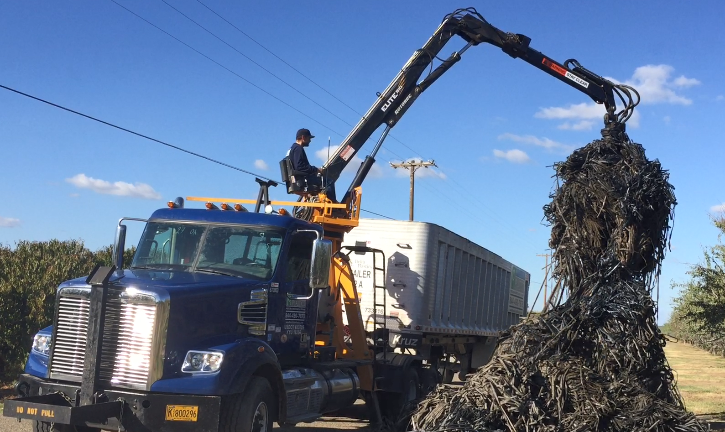
Who We Are
Revolution Plastics: The Good Plastic Company
Leading the Sustainable Plastic Revolution
We provide high-value, sustainable solutions through innovative closed-loop systems that preserve our environment for future generations
We take responsibility for our footprint by pairing 220+ million pounds of film manufacturing with 220 million pounds of recycling capabilities

Slide 10
A New Producer Standard
2
Strategic distribution partnerships
Closed-loop
manufacturing
1
3
High-quality products for various agriculture applications
5
4
Disrupt consumer film products by introducing PCR-rich products
Efficient PCR production at recycling facilities

Slide 11
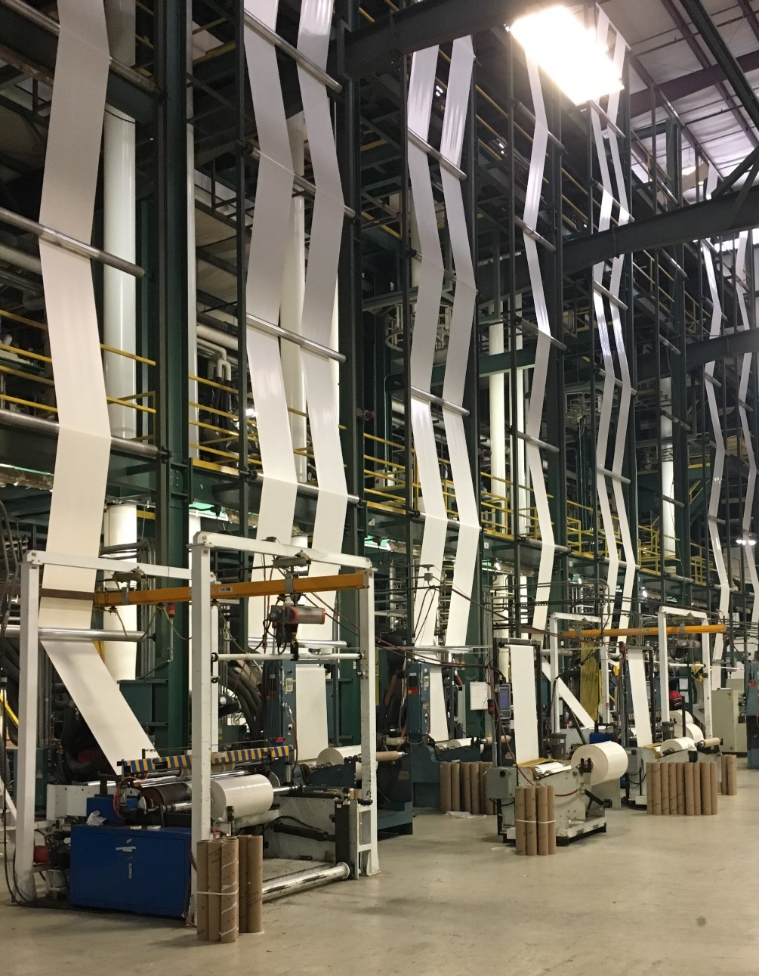
Sustainable Manufacturing
Closed Loop
Polytubing
Vine Cover
Tarp Cover
Out Loop (Single-Use Products)
Carryout Bags
Liners, Covers, Plastic Lumber

Slide 12
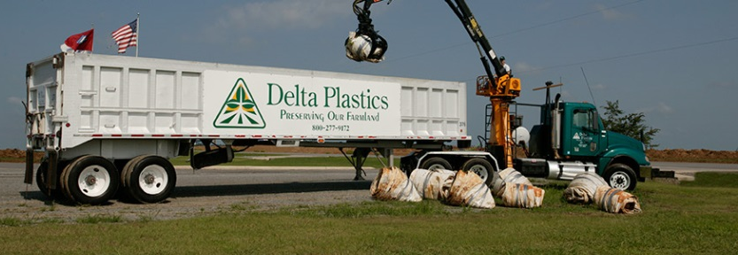
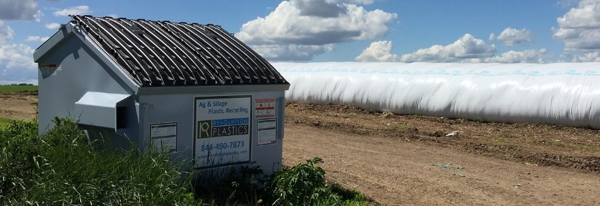
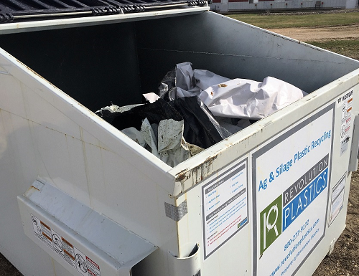
Collection Methods
Grapple Trucks
Dumpsters / Roll-offs
Collection Agreements
Fleet of over 60 grapple trucks
Over 4,000 roll-offs and dumpsters
Agreements with ag plastic manufacturers and 3rd party waste haulers

Slide 13
Materials in Monterey County
✓
We Accept and Recycle…
Sorting, Service Cost and Other Considerations
Hoop House Cover Film
Greenhouse Film
Bin Liners
Pallet Covers
Drip Irrigation Tape
We focus on materials that are 4+ mil thick
Multi-stream recycling by color in most cases is required
Plastic must be less than 10% contaminated (not including water or soil)
Charges apply for certain material types depending on staging, pick-up timing, etc.
×
We Do Not Accept…
Mulch Film
Fumigation Film
Mixed Materials
High Print Plastics
Thin Packaging Plastics

Slide 14
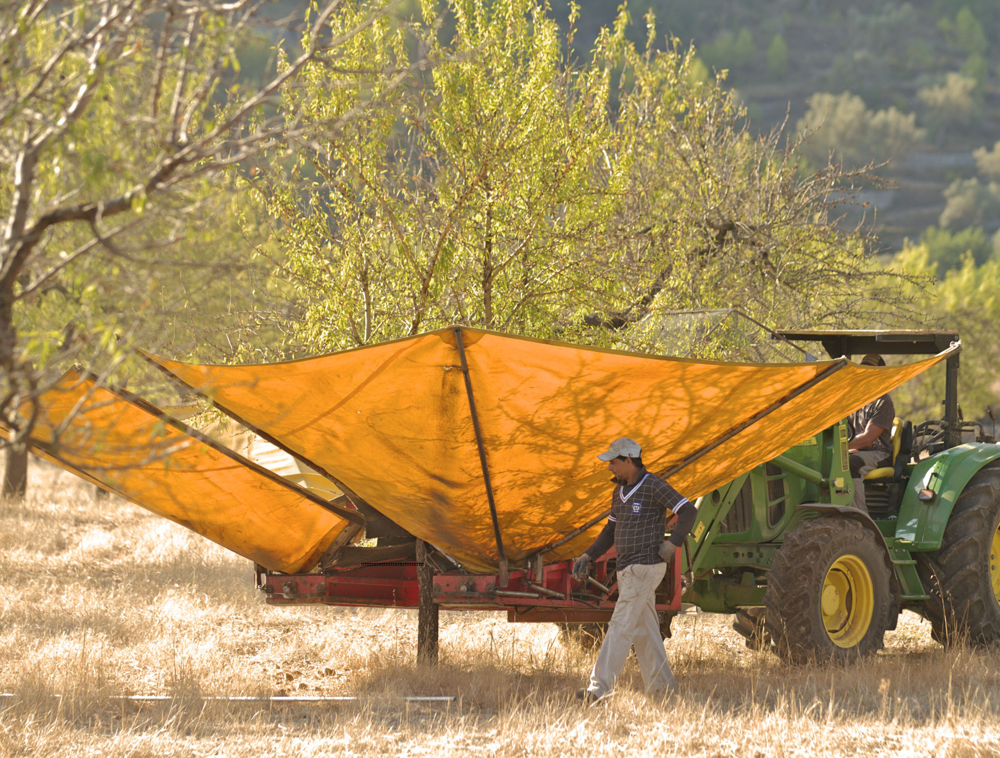
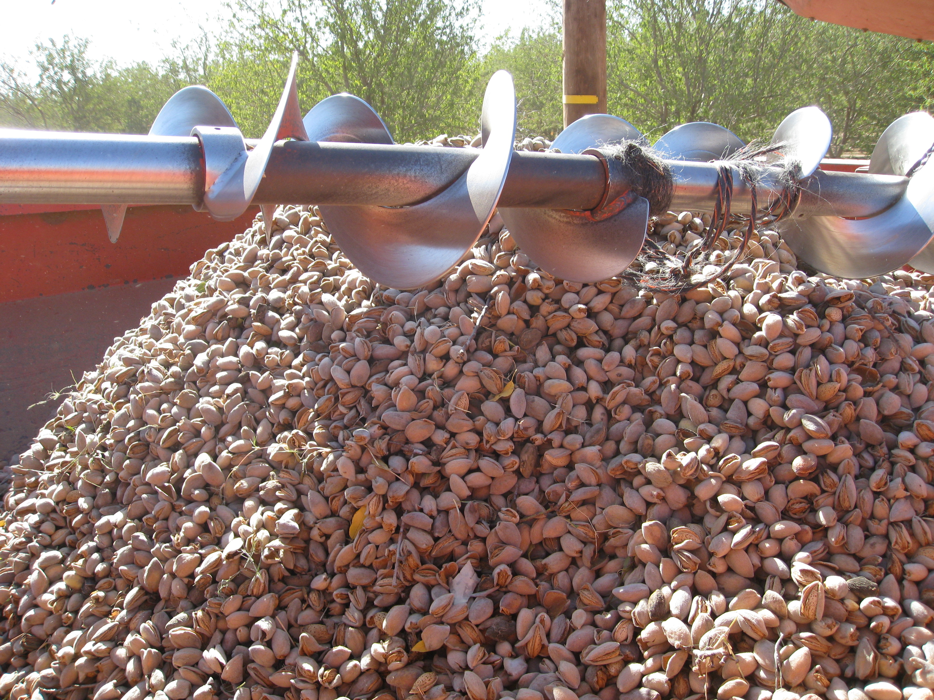
Ag Processor Case Study
Central CA Almond Growers Assoc.
Goal: Close the Loop on Previously Landfilled Cover Film
2016
Offer film collection services for co-op statewide
2017
Decrease labor costs with film removal equipment
2018
Introduce recycled content product comparable to market specifications

Slide 15
3rd Party Producer Case Study
Playbook for Success
Introduce the Missing Link to Close the Loop
Production & Sales
Ag Irrigation
Mission: Enable a closed loop process for a manufacturer improving their practices
Irrigation Use
Growers & Farmers
Action: Collaboration with Toro to educate growers about plastic best practices
Vision: Develop Toro specific PCR to unlock a Toro closed loop system in perpetuity
Recycle

Slide 16
Consumer Focused Case Study
Standard Supply Chain
Revolutionary Closed Loop Chain
Grower
Ag Film Producer
+
Grower
Consumer Interests:
- Desire for recycled product
- Growing demand for eco-friendly supply chain
National Retailer
Packaging Producer
+
National Retailer
End Consumer
=
High level of single-use products
End Consumer
=
Major reduction in waste

Slide 17
Thank You
Louis Vasquez, Director of Corporate Development
The Future of Recycling: Monterey County Produce Industry
September 2018

Slide 18
THANK YOU TO OUR EVENT SPONSORS
THANK YOU TO OUR LUNCH SPONSORS
THANK YOU TO CSUMB @ SALINAS CITY CENTER

Slide 19
THANK YOU FOR PARTICIPATING IN TODAY’S MEETING www.mcswg.org Contact: Nikki Rodoni nikki@measuretoimprovellc.com 831.594.7972

